Slide 1

Python Project II
Moïse MASSON
Due Sunday, June 2021

Slide 2
Objectives
Describe the Business Problem
Methodology
Result
Discussion & Proposed Solution
References & Appendices
Present Team Members

Slide 3

Problem
Ayiti Analytics does not know how to increase the number of students who should apply for the Bootcamp

Slide 4
What Ayiti Analytics needs ?
A strategic solution that allow them to expand their activities :
Three municipalities to be established
Increase the participation of woman in the Bootcamp

Slide 5
Methodology
We use dataset of Ayiti Analytics from various sources
From Merging Dataset, We set up a common one ;
We use Excel and Python as a statistical tools ;
Data preprocessing ;
Data transformation;
Data reduction;
Descriptive Analysis;
Bivariate Analysis ;
ntroduce the methods and data sources used for the analysis. If you have collected new data, explain the data collection exercise. Discuss your choice of variables, data, and methods and how they will help you address the problem.

Slide 6
Methodology (Suite)
250 observations have been analysed, we have used six (6) key variable to set up analysis ;
Sex : male and Female
Education_level : Level of education
have_computer_home : number of student who have a computer at home
internet_at_home : number of student who have a computer at home
Channel : communication channel by which they have heard about the Ayiti Analytics Bootcamp
Commune_FR : communes of Haiti

Slide 7
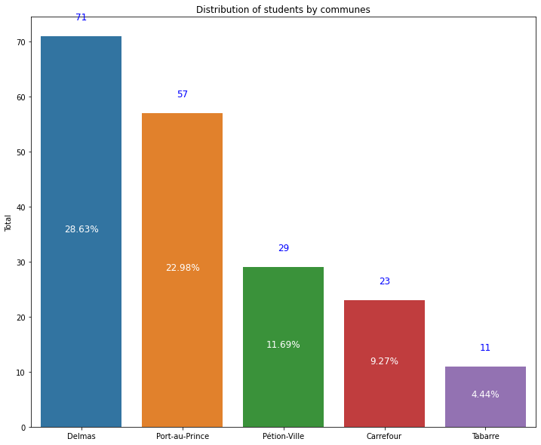
Results
28,62% Delmas
22,98% Port-au-Prince
11,69% Pétion-Ville
9,27% Carrefour
4,44% Tabarre

Slide 8
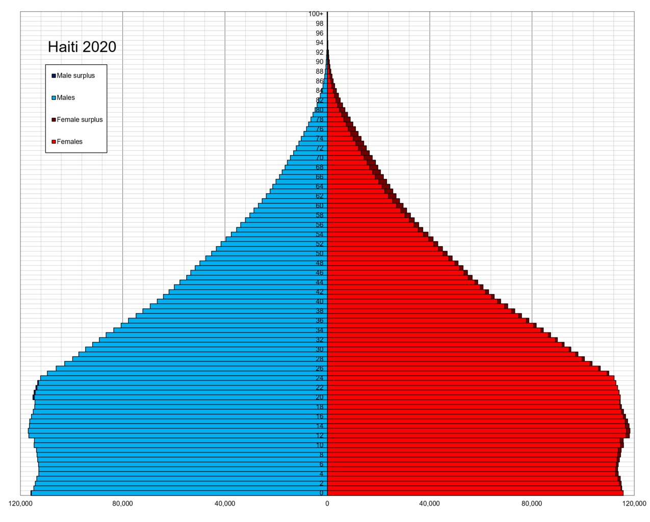
Results : Distribution by sex
75% between 24 and 30 years old
81% woman
26 % Have paid
65 % are from west

Slide 9

Results : Distribution by internet and Computer
84% have Internet
93% have compputer

Slide 10

Result : Education Level
59,2% Bachelors(bacc+4)
13,2 % High School
5,6 Master

Slide 11
Discussion & Proposed Solution
we suggest two solutions :
we choose three commune by demographic criteria (Delmas, Pétion-Ville, Carrefour)
Make more Marketing on internet to boost female participation
sponsoring woman after graduation for getting job because they likely expect that from that bootcamp.
that could help to make positive marketing and increase student participation

Slide 12
Discussion & Proposed Solution
we suggest two solutions :
Choose three commune demographic (Delmas, Pétion-Ville, Carrefour)
Choose three commune less devafored (Cité_Soleil) that could help to make positive marketing and increase student participation
Make more Marketing on

Slide 13
References & Appendices
https://towardsdatascience.com/data-preprocessing-concepts-fa946d11c825
https://matplotlib.org/
https://www.brh.ht/
https://courses.ayitianalytics.org/

Slide 14
Present Team Members
Team Member 1 : Moïse Masson
Team Member 2 : Moise Mason
Team Member 3 : Moïse Masson

